Slide 1





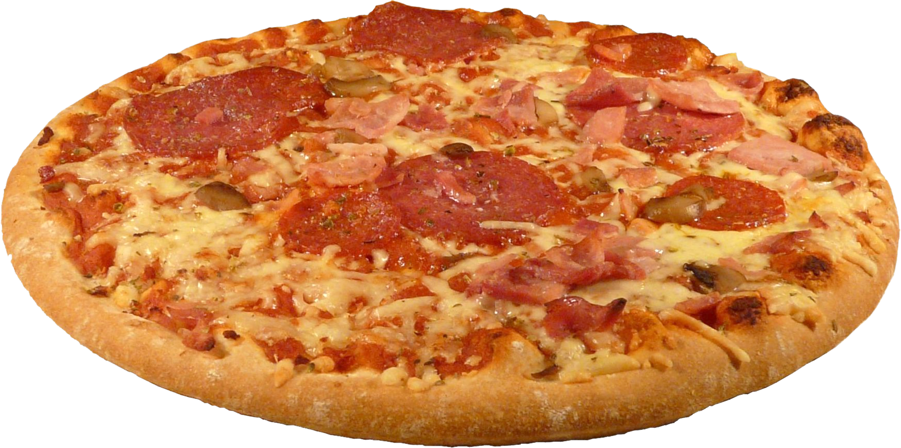

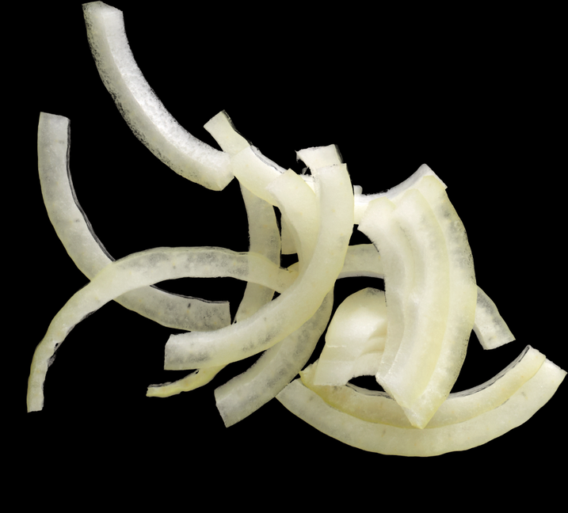

Hello my name is preethi
In this project , I have utilyze SQL query to slove questions that were related to pizzas sale.

Slide 2
Basic:
1.Retrieve the total number of orders placed.
2.Calculate the total revenue generated from pizza sales.
3.Identify the highest-priced pizza.
4.Identify the most common pizza size ordered.
5.List the top 5 most ordered pizza types along with their quantities.
Intermediate:
1.Join the necessary tables to find the total quantity of each pizza category ordered.
2.Determine the distribution of orders by hour of the day.
3.Join relevant tables to find the category-wise distribution of pizzas.
4.Group the orders by date and calculate the average number of pizzas ordered per day.
5.Determine the top 3 most ordered pizza types based on revenue.
Advanced:
1.Calculate the percentage contribution of each pizza type to total revenue.
2.Analyze the cumulative revenue generated over time.
3.Determine the top 3 most ordered pizza types based on revenue for each pizza category.

Slide 3
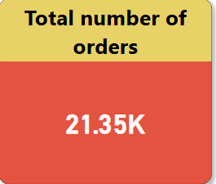
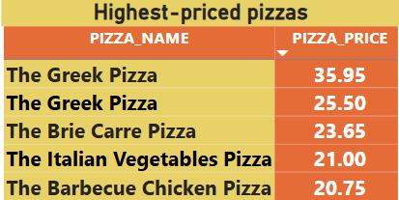
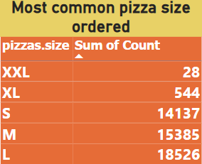
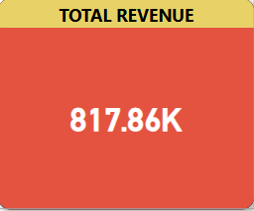
Visualize in Power BI

Slide 4
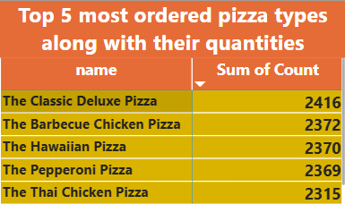
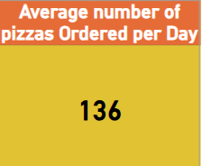
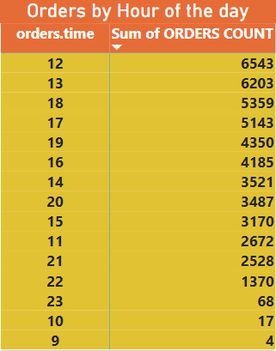
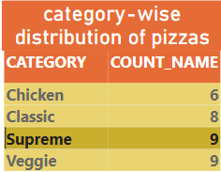
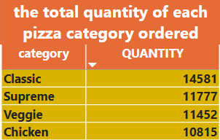

Slide 5
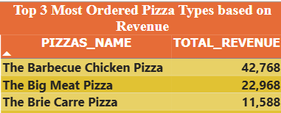
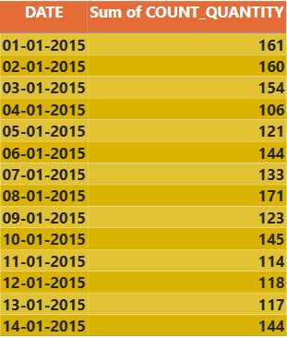
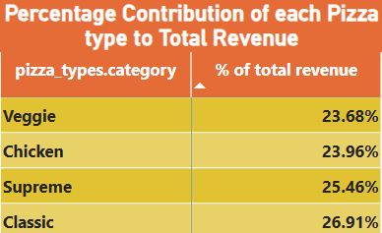

Slide 6
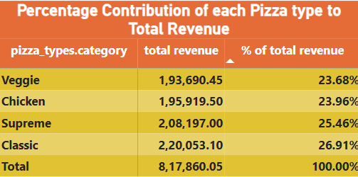
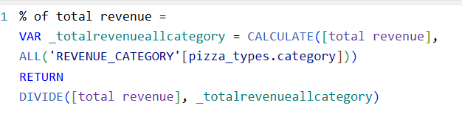

Slide 7
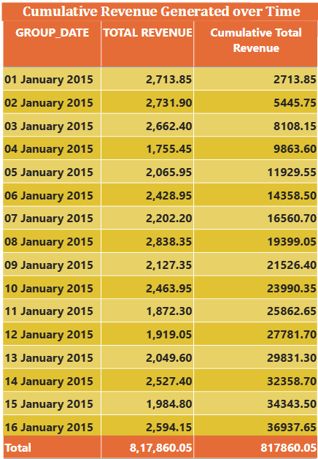
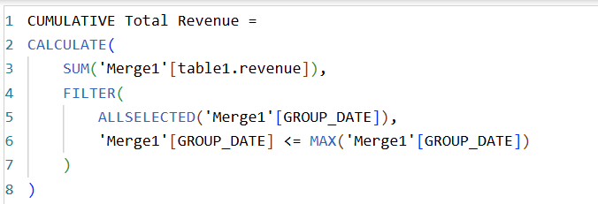

Slide 8
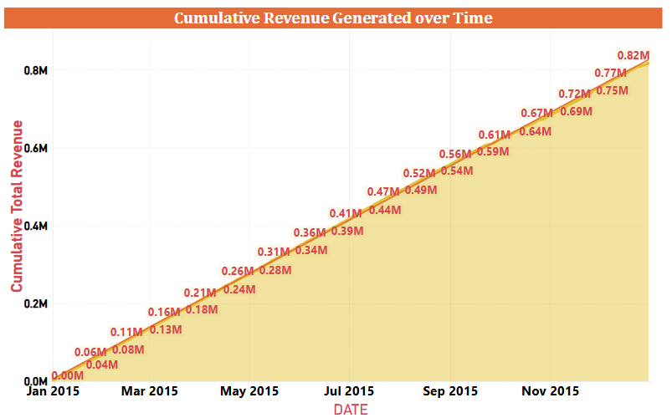

Slide 9
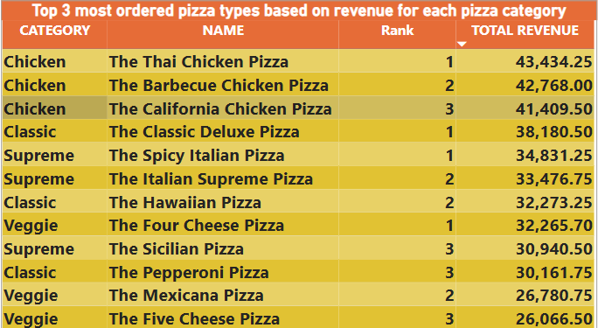
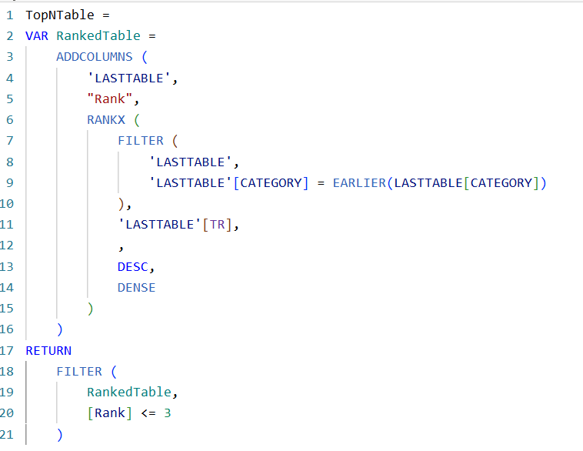

Slide 10
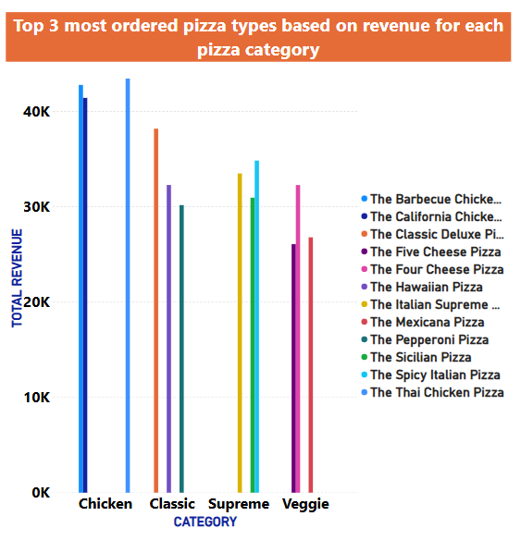
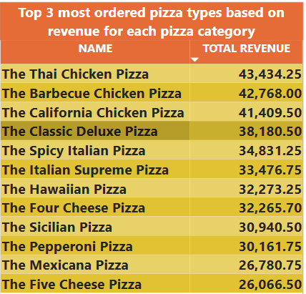

Slide 11
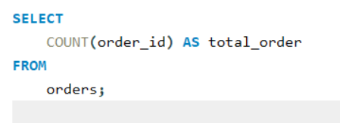
RETRIEVE THE TOTAL NUMBER OF ORDERS

Slide 12
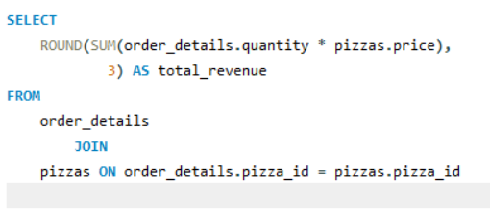
Calculate the total revenue generated from pizza sales

Slide 13
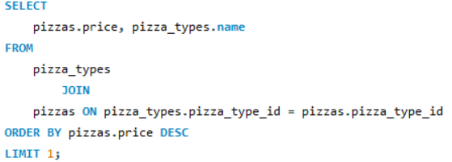
Identify the highest-priced pizza

Slide 14
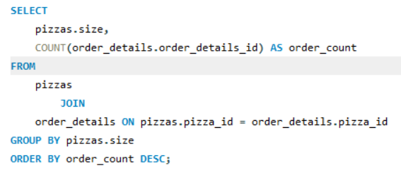
Identify the most common pizza size ordered

Slide 15
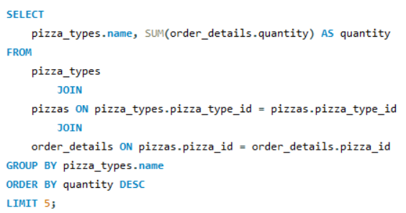
List the top 5 most ordered pizza types along with their quantities

Slide 16
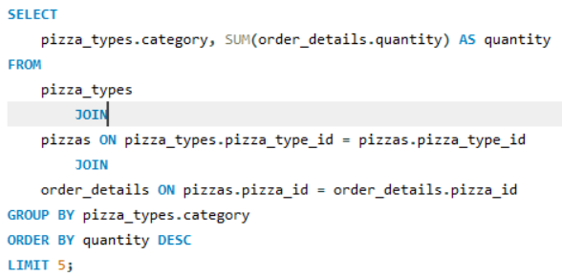
Join the necessary tables to find the total quantity of each pizza category ordered

Slide 17
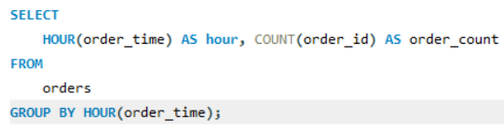
Determine the distribution of orders by hour of the day

Slide 18
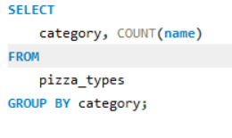
Join relevant tables to find the category-wise distribution of pizzas

Slide 19
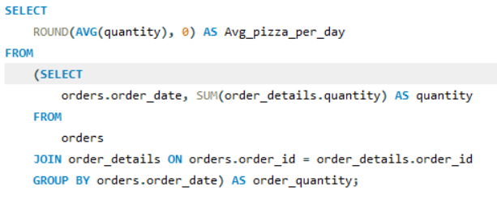
Group the orders by date and calculate the average number of pizzas ordered per day

Slide 20
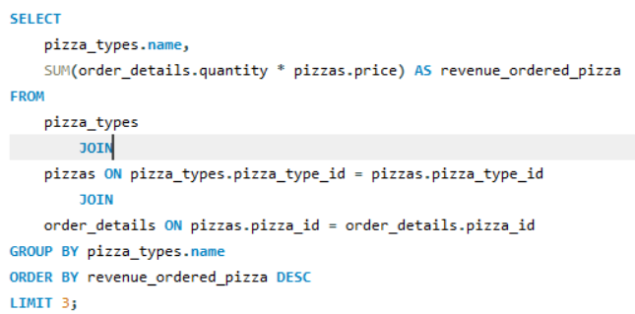
Determine the top 3 most ordered pizza types based on revenue

Slide 21
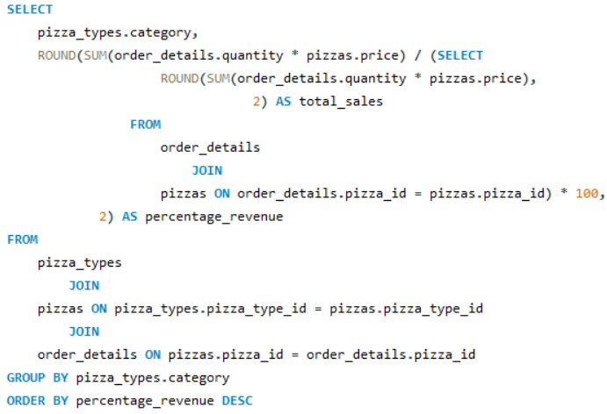
Calculate the percentage contribution of each pizza type to total revenue

Slide 22
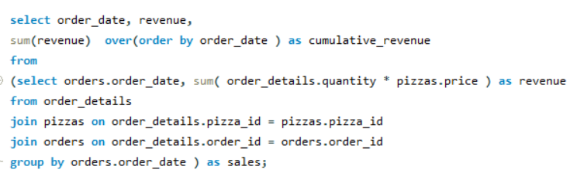
Analyze the cumulative revenue generated over time

Slide 23
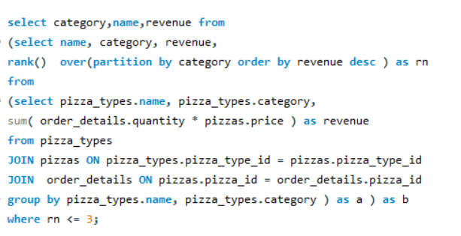
Determine the top 3 most ordered pizza types based on revenue for each pizza category

Slide 24


I'm deeply grateful for the opportunity to share this with you.

